Slide 1


Username Squatting on Online Social Networks: A study on X
Anastasios Lepipas Anastasia Borovykh Soteris Demetriou
Imperial College London Imperial College London Imperial College London

Slide 2
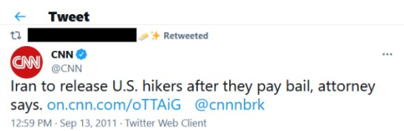
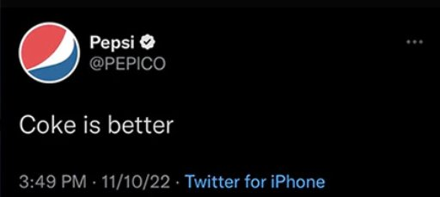
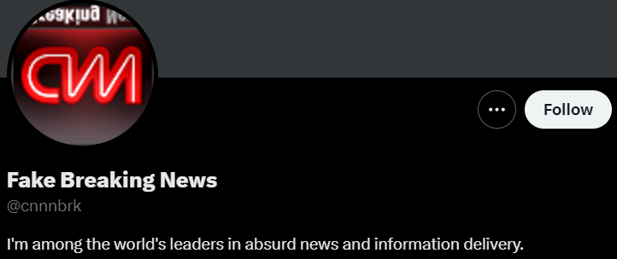
Typo-mention Impersonator
Notes:
Before starting, lets see some of our initial motivations behind this research. We manually went through the platform and here we present 2 interesting examples. On the left we see the official and verified CNN profile making a typomistake on its tweet, calling a fake cnn breaking news profile instead of the original one. On the other hand, we have a fake but also verified profile of Pepsi, with username PepiCO, making a tweet ‘Coke is better’. This migh seem funny at the beginning but it can lead to revenue loss for Pepsi.

Slide 3
What is Username Squatting?
The improper use of username accounts on social media platforms to masquerade as another
[1]: Domain - squatting
[2]: Mobile App - squatting
Squatting techniques have been applied to other domains
Domain Squatting [1]
Mobile App Squatting [2]
Skill Squatting
2
Notes:
At this point is important to define what username squatting is. It is the improper use of …

Slide 4
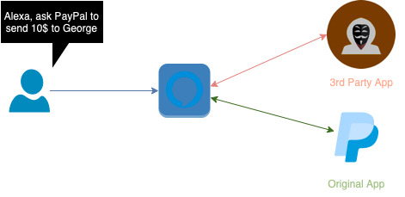
Skill - Squatting
PaayPal
PayPal
Source : Skill - squatting
Notes:
Lets see a more detailed example of what skill-squatting is. Suppose we are a user asking alexa to call a skill, which is an application. And more specifically, we say ‘Alexa ask PayPal to send 10$ to George‘. An attacker though can develop and upload to the amazon store a skill called PaayPal with double ‘aa’. Due to voice transcription errors, it is an often phenomenon Alexa to call the wrong skill, which is unsafe for the user.

Slide 5
Research Questions
1) MQ1. Is Username Squatting a prevalent problem in OSNs?
2) MQ2. How does it contribute to online confusion?
3) MQ3. What are the usernames characteristics of the most problematic bot/suspended accounts?
(not covered in this talk)
4) MQ4. What is the behavior of bots/suspended accounts? (not covered in this talk)
5) Can we use those insights to develop a tool that identifies malicious accounts?
Notes:
To return to our research, to conduct a comprehensive measurement study, we wanted to answer 4 concreate research questions. The first one is whether …

Slide 6
X's Policy
According to X’s policy [3] for usernames, a username must:
Contain:
Letters A – Z
Numbers 0 – 9
Underscores
Not contain:
Symbols
Dashes
Spaces
Be no longer than 15 characters
50 characters for the name
[3] : Usernames - Rules
Notes:
Every online social network has different policies for valiid usernames. Since our study is based on X, we will talk about X’ policy.

Slide 7
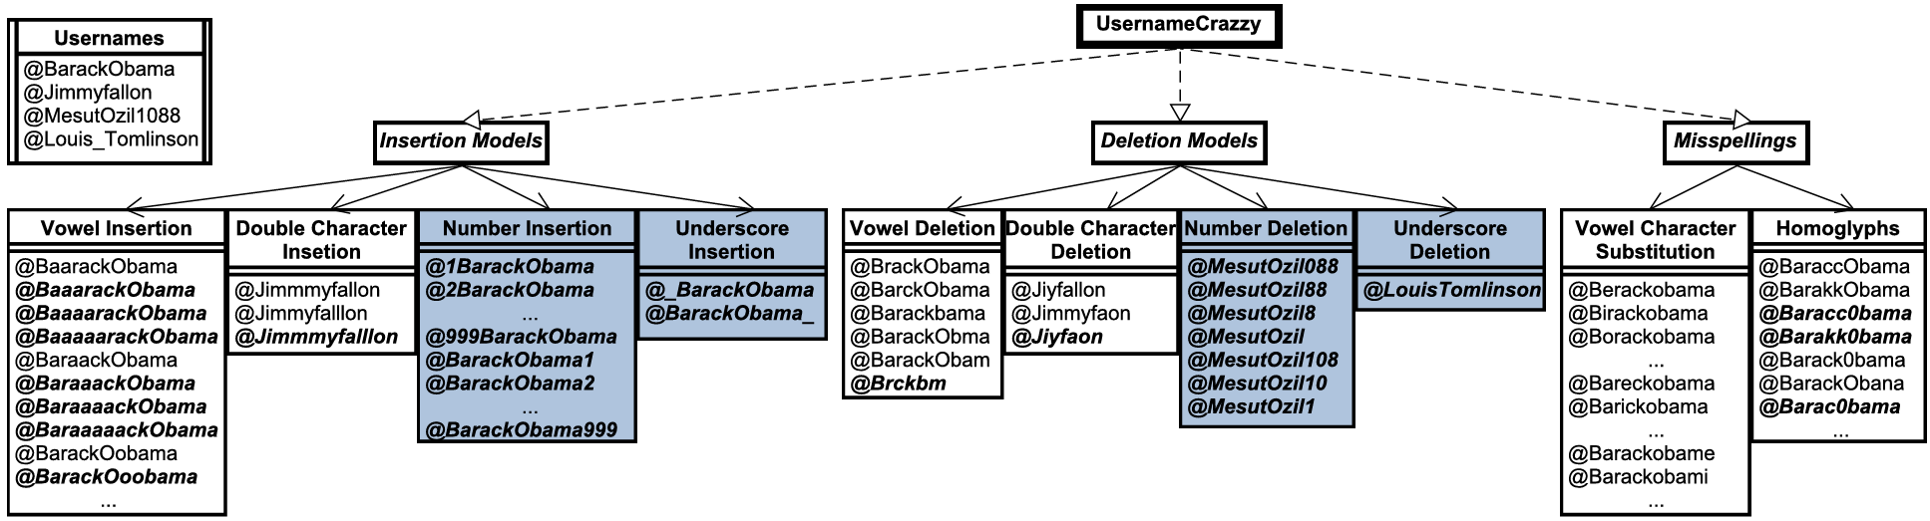
UsernameCrazy
There is a need for a new tool:
Existing ones cannot cover several patterns
10 generation models
Valid usernames:
At most 15 characters
Model stacking : @Cristiano → @Cristiaano → Cristiaano7
Notes:
Our new tool, called UsernameCrazy, is tailored to username generation. The tool consist of 10 generation models, 4 of them are completely new, you can see them in the blue. Moreover, the tool incorporates 2 unique features comparing to the other tools. The 1st one is called model self-repetition. In this case, we apply a model multiple times until the username reaches the maximum allowed characters. All the bold usernames are being created by this feature. The second feature is called model stacking, where we apply 2 or more models to generate more usernames.

Slide 8
MQ1. Is Username Squatting a prevalent problem in OSNs ? (1)
Dataset:
Source: Kaggle 2019
Top 97 profiles
Platform:
Χ
UsernameCrazy:
842,646 usernames generated
43,994 exist
11,827 have been suspended
Notes:
For our 1st research question, once again the studied platform is X. We used a dataset from Kaggle with top 100 authors.

Slide 9
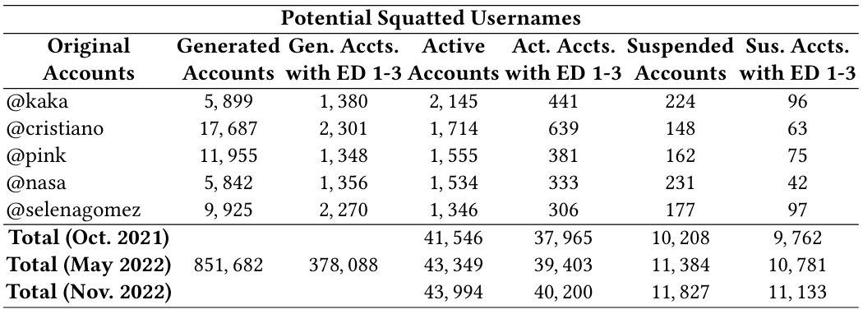
MQ1. Is Username Squatting a prevalent problem in OSNs ? (2)
3 snapshots
Notes:
During a 2 year period, we took 3 different snapshots. We can observe that as time goes by both the active and suspended accounts are being increased, indicating that indeed the usernames that we generate are being used by the individual to the social network.

Slide 10
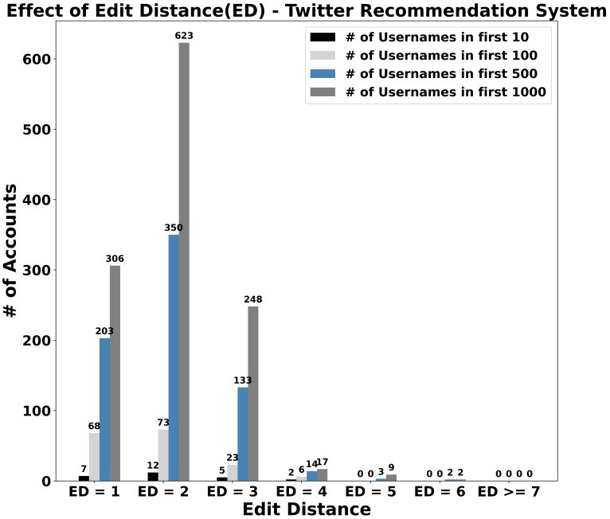
MQ2. How does it contribute to online confusion ?
Squatted accounts are being prioritized in searches by the network’s search recommendation algorithm
X’s suggestion algorithm:
26 appear in top-10
170 appear in top-100
17 Impersonators
66 Malicious
Notes:
For the 2nd research question, the X’ suggestioin algorithm, which is in the search bar of the platform, tend to return squatted usernames in higher position than the verified ones.

Slide 11
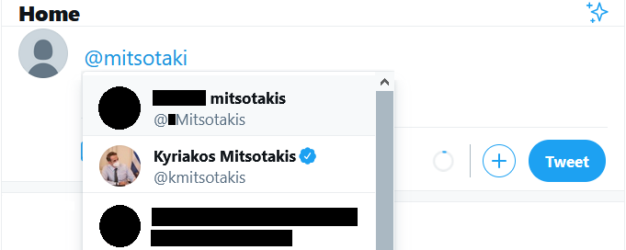
Notes:
Let’s see another interesting examples. We observe that a verified user, which is the prime minister of Greece, is returned a 2nd option in the list. However, both usernames have ED = 1.

Slide 12
Dataset
2 independent raters:
1500 random generated accounts
540 active malicious users
960 benign profiles
Notes:
Before moving to our classification section, lets talk about our dataset. We randomly selected 1500 users out of all the existing ones. 2 independent raters went through them and 540 …

Slide 13
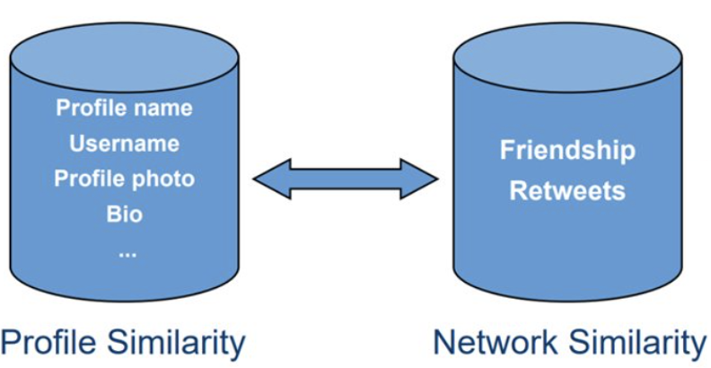
Design & Features
Design:
Filtering Component
Feature Extraction
12 distinct features
Tools-Metrics:
Photo Similarity : VGGFace2
Text Similarity : Levenshtein Distance
Notes:
As for the features we used, we examined profile and network similarities. For profile similarity, we examined the profile name ed, usename ed etc. For any text similarity we use Leven…

Slide 14
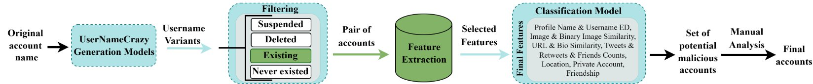
Framework - Overview
Notes:
Lets see an overview of our e2e framework, called SQUAD

Slide 15
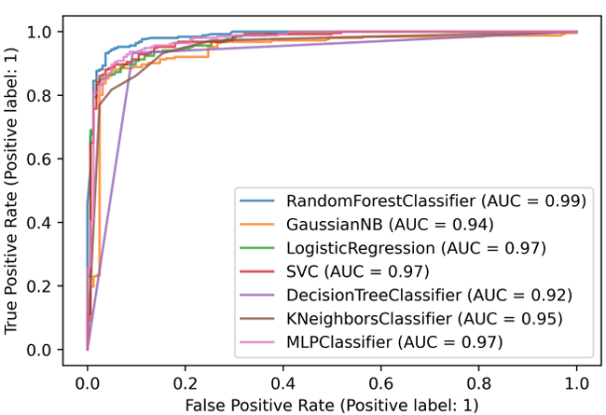
Classification Results
2 classes:
Benign
Humans, Fan & Parody accounts, etc.
Malicious
Impersonators, Confusion attempts
Best Model (Random Forest):
Accuracy : 94.44%
F1 – Score : 94%
FP : 15
FN : 8

Slide 16
Responsible Disclosure
All the manually verified impersonators reported to X
X’s response:
They already provide additional controls
Allow users to report these accounts
Problem:
Weak crowdsourcing method
Suffer from erroneous reports
Does not scale

Slide 17

Questions?
GitHub : APSS-Imperial/SQUAD
Website : Squad-Framework
Thank you!
Notes:
In our website you can find some extra interesting examples of typo-mistakes, malicious links and impersonators. Lastly, within the day, on GitHub you can find our code for the e2e framework but also for our tool.

